Slide 1
BMWG – Containerized Infrastructure Benchmarking
IETF 111
July 19-23, 2020
Online

Slide 2
Hackathon Plan
The main goal is to figure out container networking performance impacts by various resource options.
Related Draft: Considerations for Benchmarking Network Performance in Containerized Infrastructures ​https://tools.ietf.org/html/draft-dcn-bmwg-containerized-infra
Two main features
Implementing containerized infrastructure with various network models
Verifying performance impacts depending on configuration settings

Slide 3
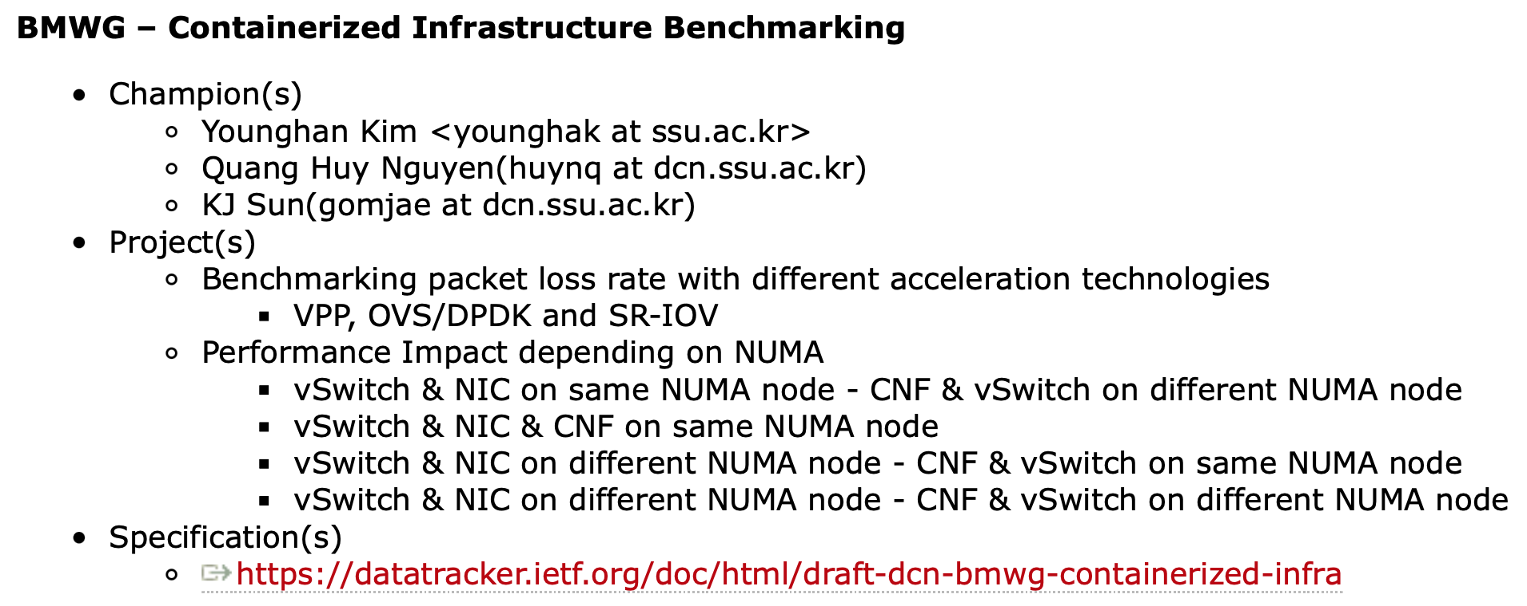
Hackathon Plan
Plan for Hackathon-110

Slide 4
What got done
Discussion for draft update
Need to clear definition and description of container networking
Gathering benchmarking experience done by other communities (ViNePERF in Anuket, userspace-cni, Intel, ..)
Re-Classification of network model
From vSwitch aspect

Slide 5
What got done
Benchmarking Scenario - Networking Acceleration
OVS-DPDK / VPP
SR-IOV
C-VNF
* In both case, Multus CNI plugin is needed to create multiple interface of VNF
C-VNF
virtio-user
virtio-user
vhost-user
vhost-user
VF driver
VF driver
* For SR-IOV scenario, SR-IOV plugin in DPDK mode is needed to create VF driver of VNF
OVS-DPDK/VPP
PMD
Kernel
Kernel
* C-VNF : L2fwd
VF
VF
NIC
SR-IOV NIC
Port
Port
Port
Port
Port
Port
Port
Port
Traffic Generator (T-Rex)
Traffic Generator (T-Rex)

Slide 6
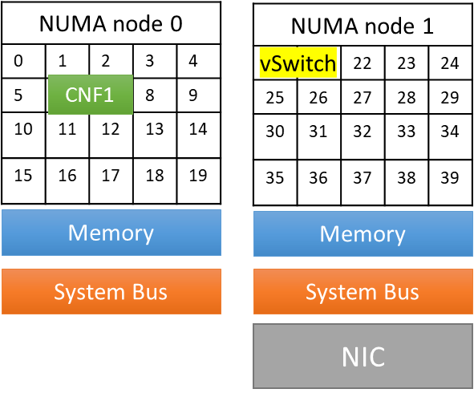
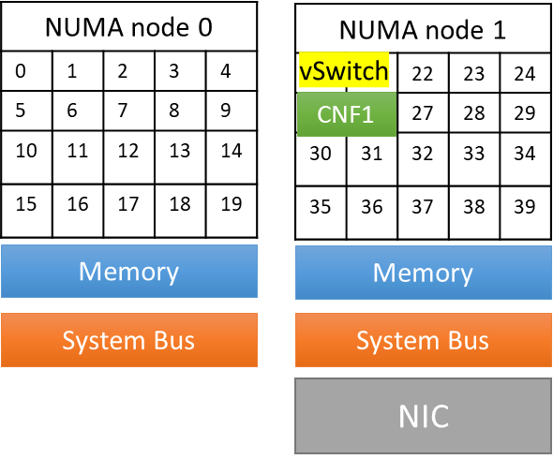
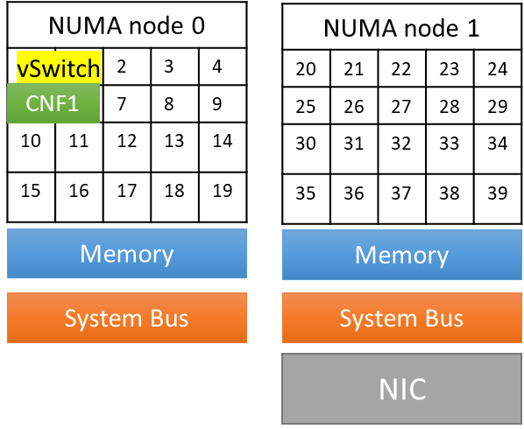
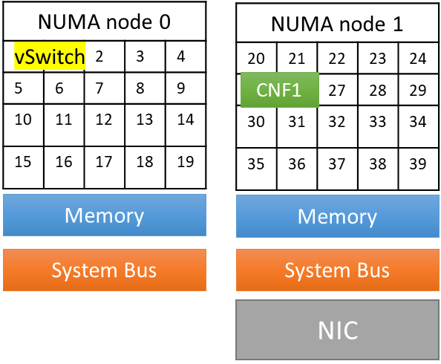
What got done
Benchmarking Scenario – NUMA Affinity
With OVS-DPDK / VPP, we compare network performance with different NUMA zone
NIC & vSwitch on same NUMA node
Scenario1 (s1)
Scenario2 (s2)
NIC & vSwitch on difference NUMA node
* This scenarios are based on “Cross-NUMA test” case in ViNePERF from Anuket project (OPNFV vsperf in previous)
Scenario3 (s3)
Scenario4 (s4)

Slide 7
What got done
Benchmarking Configuration
Hardware
Software
CPU | Intel(R) Xeon(R) Gold 5220R CPU @ 2.20GHz 48 CPU cores * 2 NUMA nodes
Memory | 256GB: 32GB x 4DIMMs x 2 NUMA nodes @ 2400MHz
NIC | Intel Corporation Ethernet Network Adapter X710-DA2 10Gbps
Microcode | 0x5003102
Intel NIC Device ID | 0x1572
Intel NIC Firmware version | 6.01 0x800035cf 1.1747.0
BIOS setting | CPU Power and Performance Policy <Performance> CPU C-state Disabled CPU P-state Disabled Intel(R) Hyper-Threading Tech Enabled Turbo Boost Disabled
Operating System | CentOS Linux 7
Linux Kernel Version | 3.10.0-1160.31.1.el7.x86_64
GCC version | gcc version 4.8.5 20150623 (Red Hat 4.8.5-44)
DPDK version | 20.11
Traffic Generator : T-Rex

Slide 8
What we learned
Benchmarking Results

Slide 9
What we learned
Benchmarking Summary
For packet loss measurement, results were not consistency at every tests trials
T-Rex problem? Or other reason..
The results of the NUMA-Affinity test were mostly similar to the expected values
But in the small size packet, throughput was measured in terrible to use
Future Works
Benchmarking results and trouble-shootings will be contributed to our draft
Based on our full experiments of hackathon from IETF 106, plan to discuss with other related community (e.g., ViNePERF in Anuket) for improving BMWG work

Slide 10
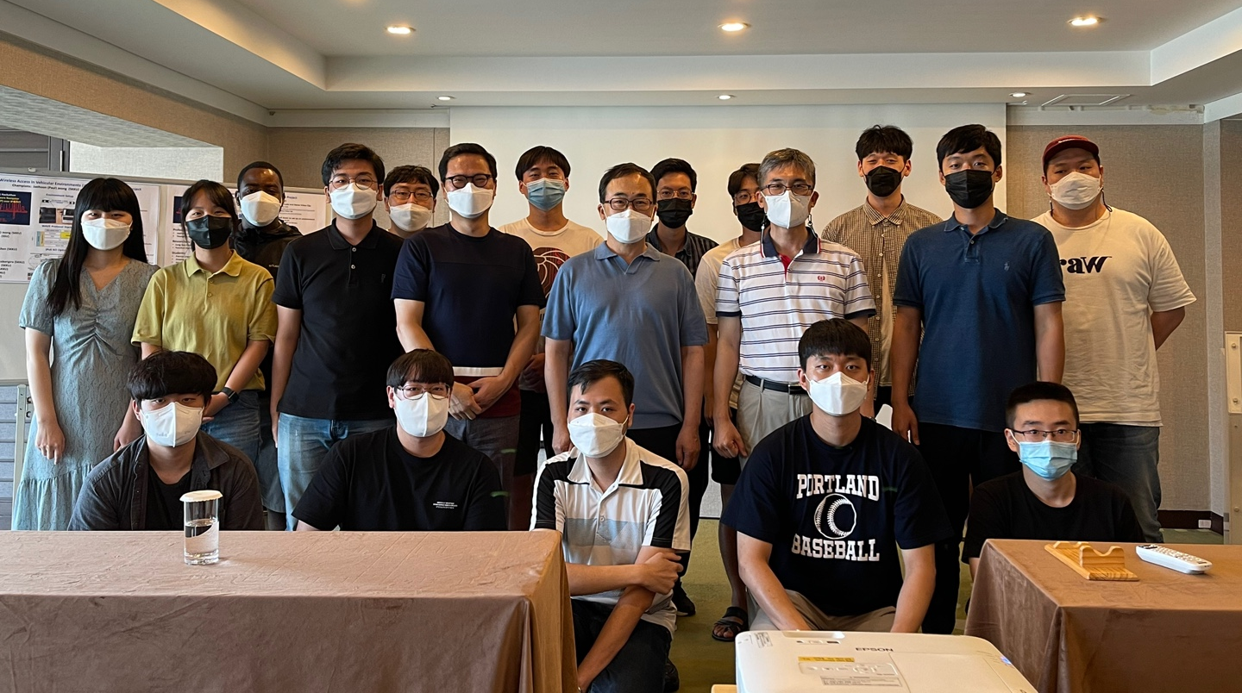
Wrap Up
Team members:
Younghan Kim (SSU)
KJ Sun (SSU)
Quang Huy Nguyen (SSU)
Jangwon Lee (SSU)
Hokeun Lim (SSU)
Minh Ngoc Tran (SSU)
Git repo:
https://github.com/huyng14/bmwg-container-networking
IETF Korea Forum:
Remote Hackathon Event at Busan
with I2NSF, IPWAVE (SKKU team)

Slide 12
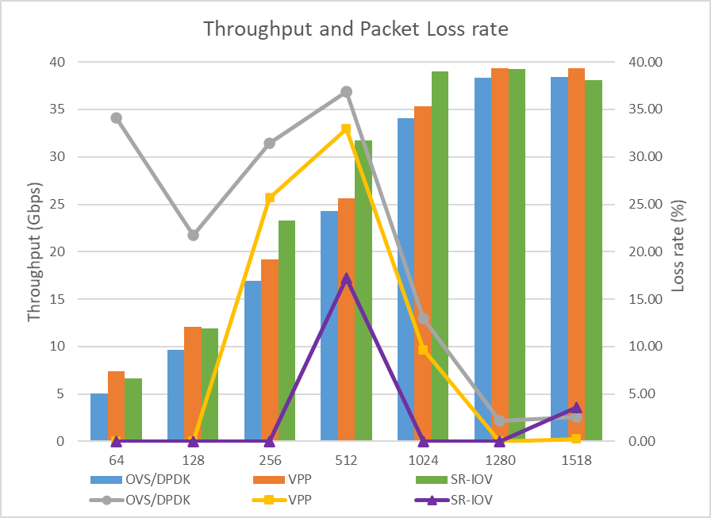
What we learned
Accelaration Techniques Performance Comparison
Throughput when increasing packet size
Results
SR/IOV has highest throughput, then
VPP and OVS
The gap between 3 techniques reduces
as packet size increases
SR-IOV has the most stable packet loss rate
outperforms VPP and OVS
Explanation
Reason 1
Reason 2
Reason 3

Slide 13
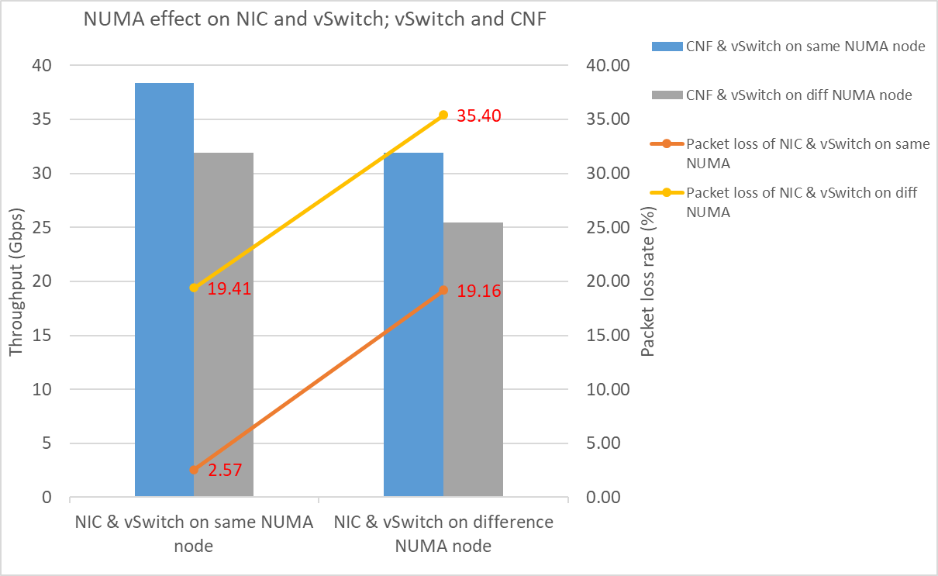
What we learned
NUMA effects on Accelaration Techniques
Scenario 1: Single container on Single host
Results
CNF & vSwitch on same NUMA
has better throughput and packet
loss rate than on different NUMAs
NIC & vSwitch on same NUMA has
better performance than on different
NUMAs
Explanation
Reason 1
Reason 2
…

Slide 14
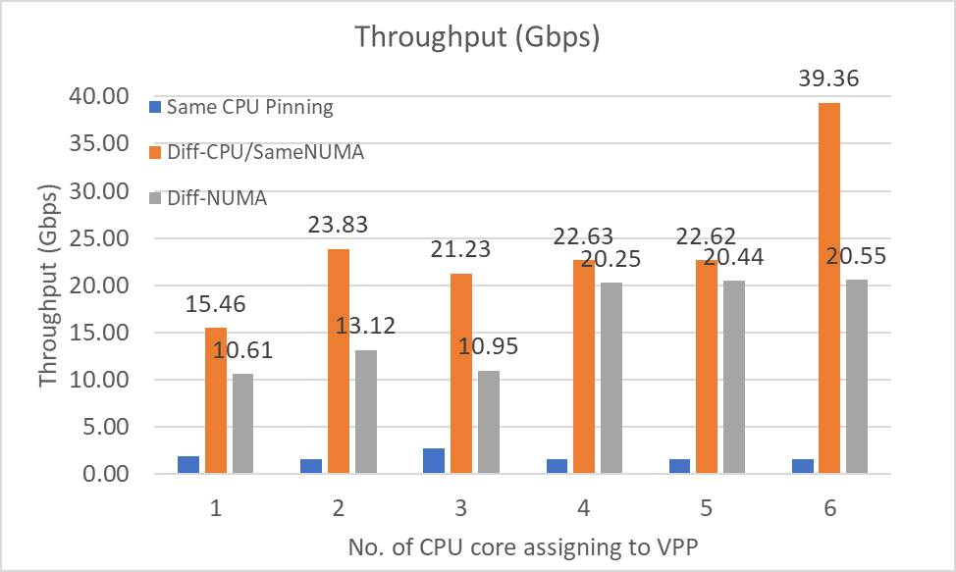
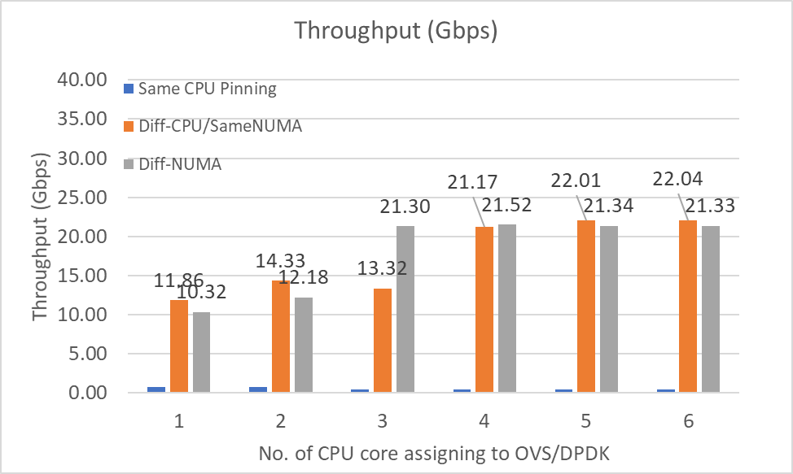
What we learned
NUMA effects on Accelaration Techniques
Scenario 2: Multiple containers on Single host
Test Results

